Slide 1

CircuitPython

Slide 2
What is CircuitPython?
Programming language based on Python, but with hardware support built in
“The easiest way to program micro-controllers”
Meant as an entry-point for both beginners in programming and beginners in micro-controller programming
“designed to simplify experimenting and learning to program on low-cost microcontroller boards”
fork of the MicroPython programming language originally created by Damien George
Maintained by Adafruit

Slide 3
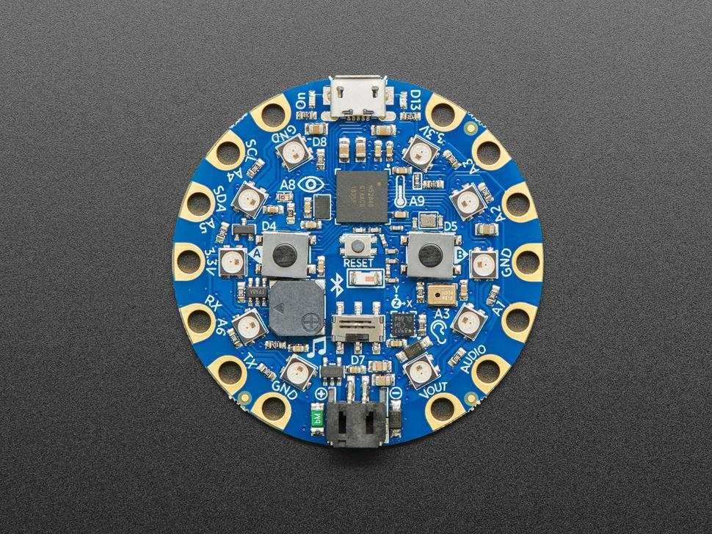
CircuitPlayground Bluefruit
- device which can run CircuitPython
- nRF52840 Cortex M4 processor with Bluetooth Low Energy support (micro controlling unit, short mcu)
- various sensors, e.g. temp, sound, light
- 10 neo pixels (leds)
- 2 MB of SPI Flash storage, used primarily with CircuitPython to store code and libraries
- MicroUSB port for programming and debugging

Slide 4
Example 1: rainbow lights when slide switch is switched on
Want to make the device switch on the leds one after each other in pastel rainbow colours
Want to do so when the slide switch is switched on

Slide 5
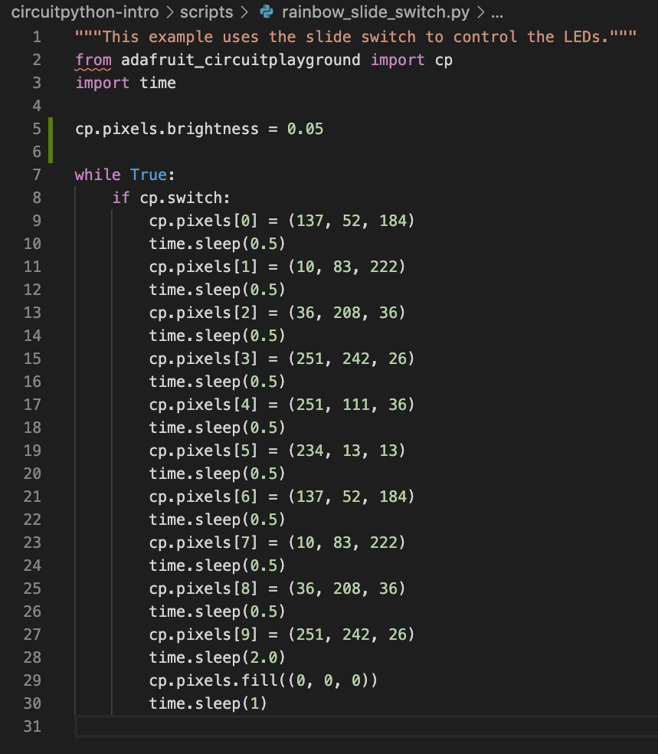
Code

Slide 6
Example 2: connect via app and choose colour for pixels
Would like to connect to the device with the phone via adafruit app
Would like to control colour of leds via the app
Requirements:
Adafruit app installed on phone (IOS or Android)
Adafruit Buetooth libraries on device (available here)

Slide 7
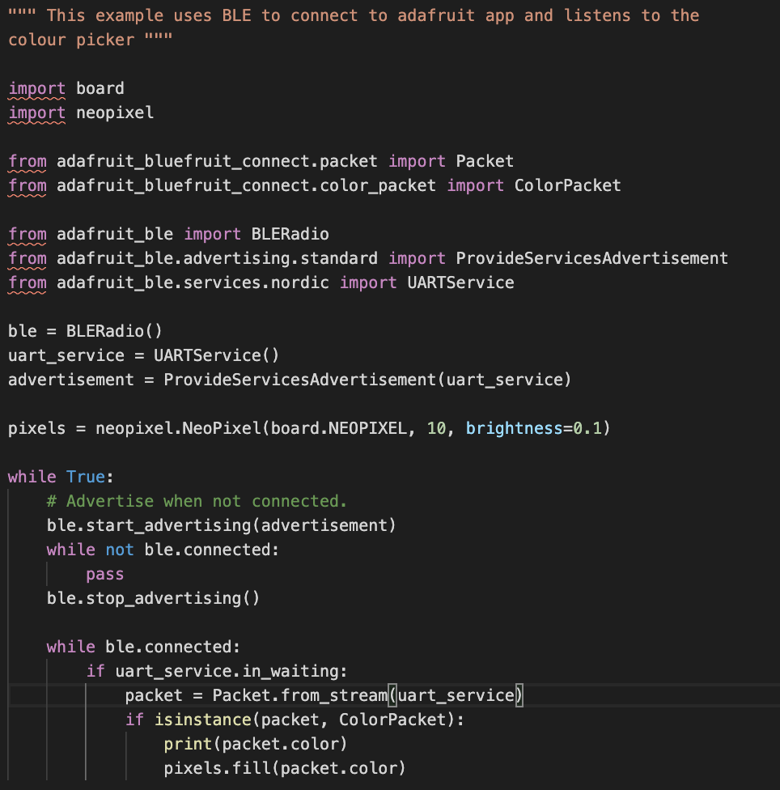
Code

Slide 8
Example 3: Send email when device is shaken
Would like to detect when device is shaken via accelerometer (motion sensor)
Want to send an email when this has been detected
Requirements:
Need code which detects shaking and triggers somehow email sending
Need code which takes care of the email sending

Slide 9
Example 3: Send email when device is shaken
Implementation:
Use small piece of code on device to detect shaking and let it print out that it has been shaken
Use python program on computer to listen to device
When program on computer detects certain message, send email

Slide 10
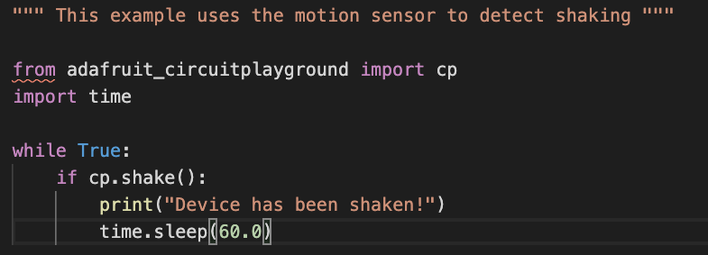
Example 3: Send email when device is shaken
Code on device

Slide 11
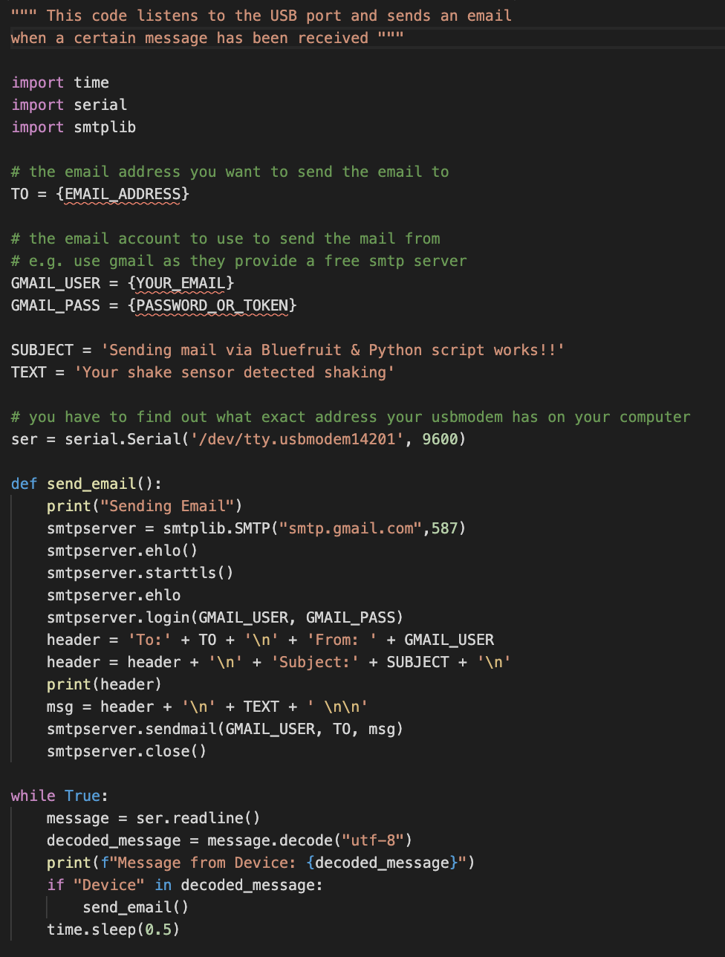
Example 3: Send email when device is shaken
Code running on computer ->

Slide 12
Useful Links and Resources
https://github.com/MissMathmagician0/circuitpython-intro -> slides and all code examples
https://circuitpython.org/ -> official homepage of the project
https://github.com/Adafruit/CircuitPython -> github repo
https://learn.adafruit.com/welcome-to-circuitpython/what-is-circuitpython -> nice beginner guide with instructions and examples
https://www.adafruit.com/product/4333 -> circuit playground bluefruit

